Slide 1
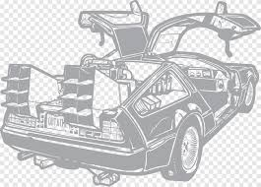
DeLorean Automobiles
Case Study
Bella Jean
Adil Fayyaz
Arman Hosseini

Slide 2
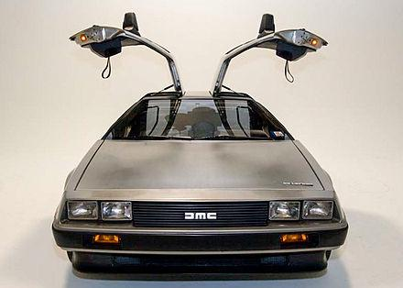
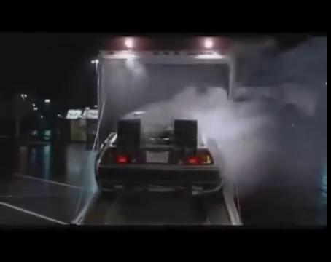
CASE SURVEY
The DMC DeLorean is a sports car and the only automobile manufactured by John DeLorean's DeLorean Motor Company (DMC) for the American market from 1981 to 1983. The car was designed by Giorgetto Giugiaro and stood out for its gull-wing doors and brushed stainless-steel outer body panels.
It is memorable for its appearances as the time machine in the Back to the Future media franchise after 1985.
It became widely known for its disappointing lack of power and performance, which did not match the expectations created by its looks and price tag.
Notes:
When details surrounding the DeLorean first started to be revealed in the mid-1970s, there were numerous plans and rumors that the DeLorean would have myriad advanced features, such as elastic reservoir moulding (ERM), a unit construction plastic chassis, a mid-engine layout, airbags, 10 mph bumpers and Pirelli P7 tires; none of them would materialize in the production vehicle.
DeLoreans, early production models in particular, suffered from poor build quality as well as mechanical issues. Early production cars needed as much as 140–200 hours of work at DMC Quality Assurance Centers prior to being shipped to dealerships for delivery. DMC eventually sent 30 factory workers to the quality centers in the US to learn about the problems and how to fix them.
The lack of quality service at dealerships was a point of frustration for many DeLorean owners at the time, particularly those who paid over sticker price to purchase one of the first cars

Slide 3
DEFINITION OF ECONOMIC TERMS AND NOTIONS
The minimum efficient scale (MES) The lowest point where the plant (or firm) can produce such that its long run average costs are minimized.
The law of supply price and quantity supplied of a good and service are directly related to each other.
Cost overruns Amount by which the actual cost exceeds the budgeted, estimated, original, or target cost.
The law Demand price and quantity demand of any good and service are inversely related to each other.
Break-even point the level of production at which the costs of production equal the revenues for a product.

Slide 4
THE PROPOSED ECONOMIC MODELING OF THE CASE
*QD: quantity demanded
*QS: quantity supplied
Price (P)
25,000$
Demand
Supply
Excess Supply
QD
QS
P*
Equilibrium
* Break-even point: 10000-12000
Break-even point > supply > demand
6000
(QD)
9000
(QS)
Q (quantity)
Q*

Slide 5

Sources
https://www.britannica.com/technology/DeLorean-DMC-12
https://www.automobilemag.com/news/dmc-delorean-history-generations-specifications-photos/

